Slide 1

Effects of Cost of Capital on Financial Profile
Students name
University

Slide 2

Introduction
Cost of capital implies the required returns that are necessary in preparing firms capital budgets on projects and investments.
Investors and analysts define the cost of capital as firms weighted average cost of debt and equity cost concoction together.
In Exxon Mobil, cost of capital is used internally to establish whether their planned capital projects are worthy their resource expenditure, and it always depends on financing mode utilized.

Slide 3
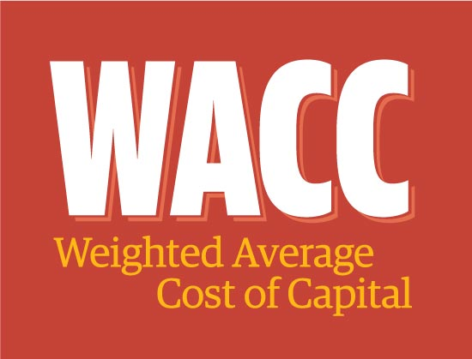
Effects of cost of Capital on Financial Profile
Exxon Mobil got profitable capital structure that can maximize stock wealth
shareholders rate of return can be evaluated by the use of equity beta borrowed from CAMP
The lowest WACC triggered by certain debt-equity ratio results to the firm’s optimal capital structure.

